Slide 1
X-LIBRIS
USER ORIENTED LIBRARY SERVICES IN VARNA PUBLIC LIBRARY

Slide 2


X-Libris USER ORIENTED LIBRARY SERVICES

Slide 3

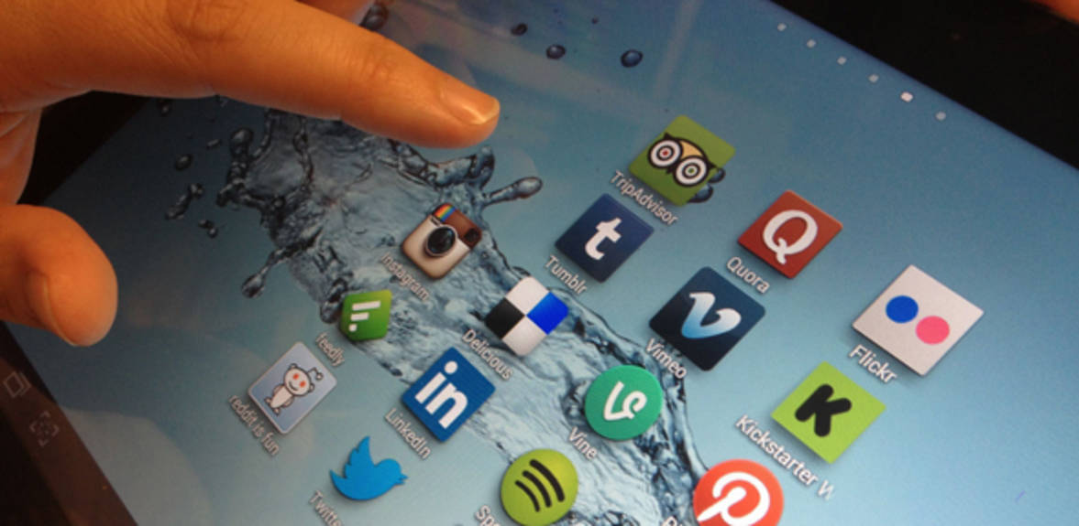
webinars for using social media
Online trainings for presenting and promoting libraries in social networks as Pinterest, Instagram, Vimeo, Facebook, YouTube
Notes:
Insert a map of your country.

Slide 4
webinars for using social media
Background for developing the service
Formal and informal trainings in the library
Professional trainings with the help of ICT
Platforms for distance trainings (webinars)
Notes:
Insert a map of your country.

Slide 5
webinars for using social media
Target groups
Librarians in public libraries
Community libraries (‘chitalishte’)
School libraries
Notes:
Insert a map of your country.

Slide 6
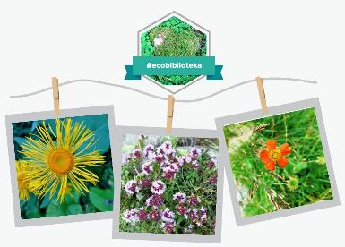
webinars for using social media
Webinar ‘Ecolibrary’- an example for developing a new library service
Reveals the opportunities of social media for promoting informational resources
Notes:
Insert a map of your country.

Slide 7
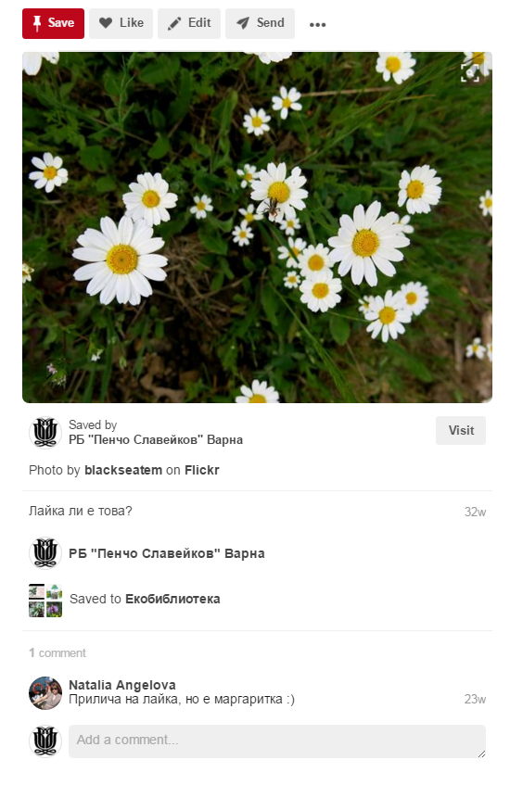
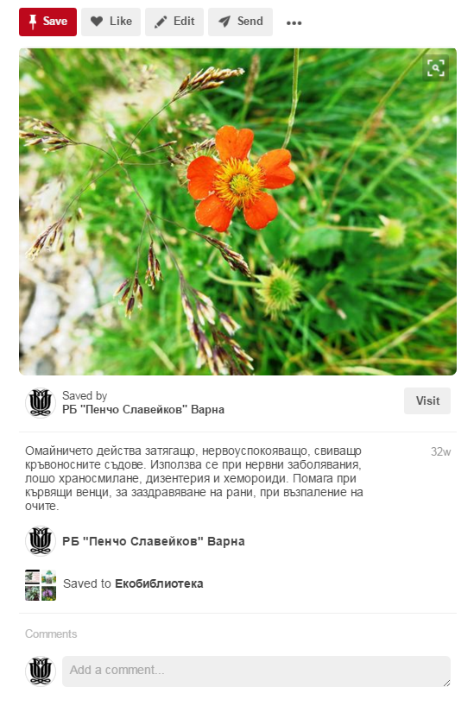
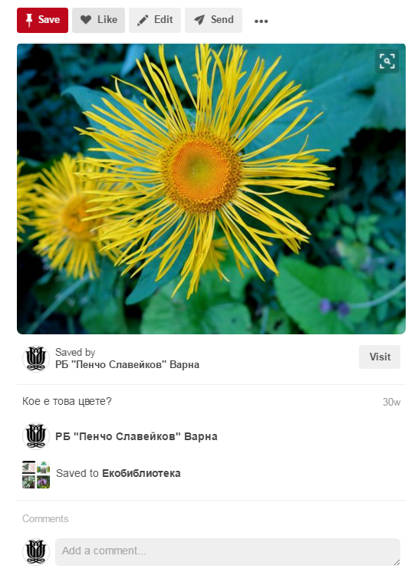
webinars for using social media
Notes:
Insert a map of your country.

Slide 8
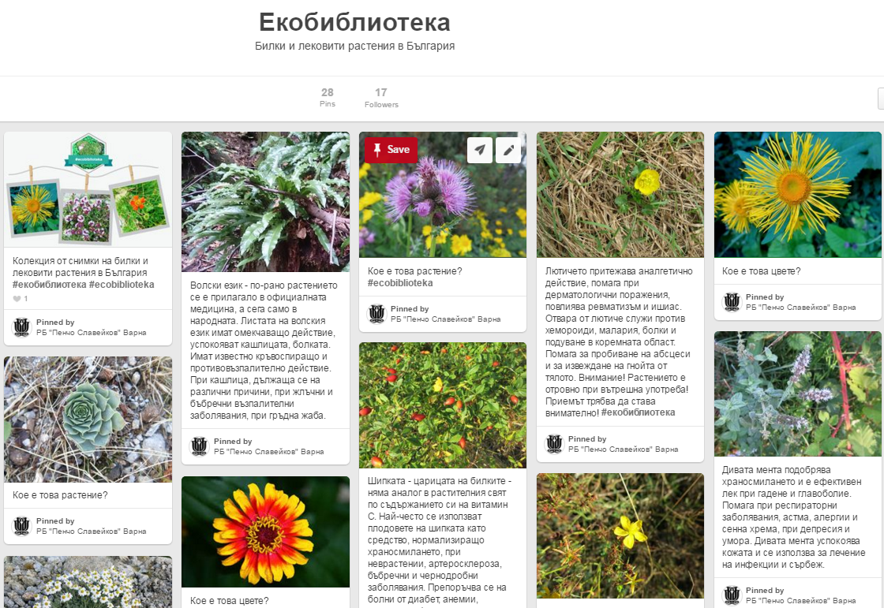
webinars for using social media
Notes:
Insert a map of your country.

Slide 9
webinars for using social media
In December 2015 the second webinar was organized about sharing creative ideas on Pinterest
Some of the participants from the first one took part again
Some problems were discussed when using the social media and the successfully created boards were presented
Notes:
Insert a map of your country.

Slide 10
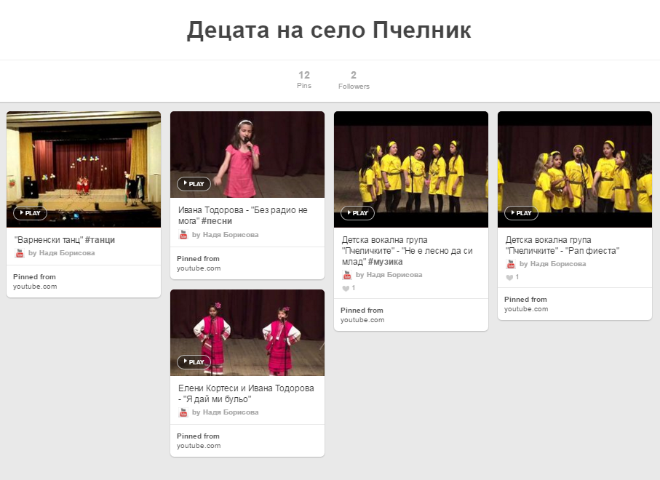
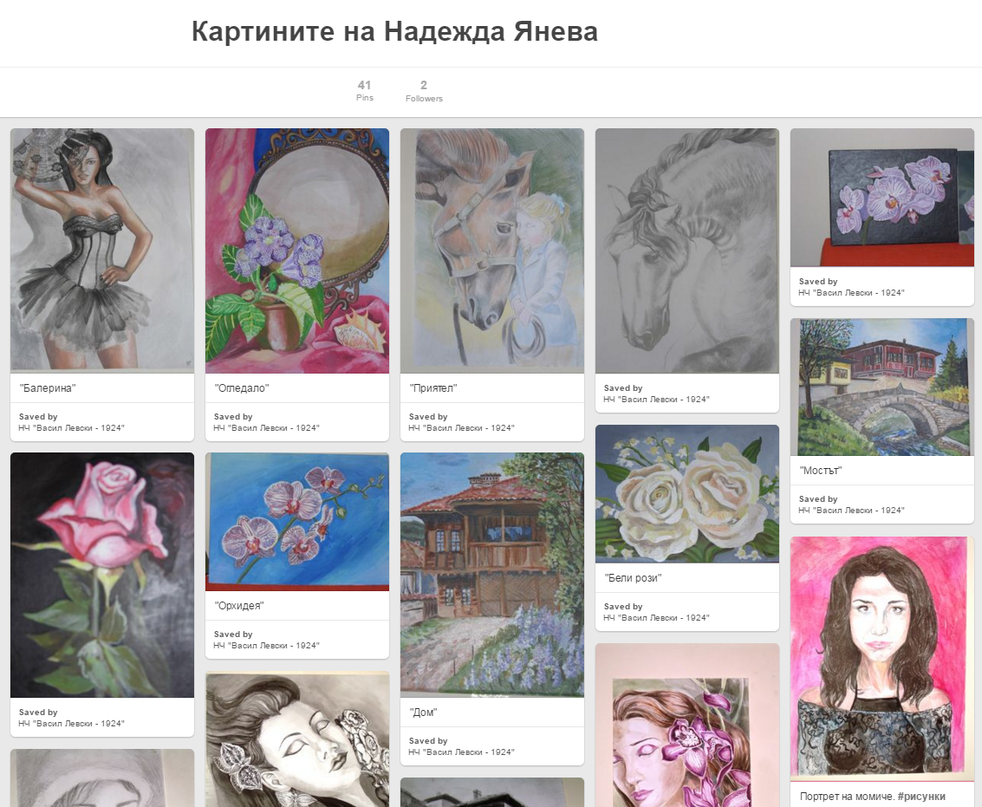
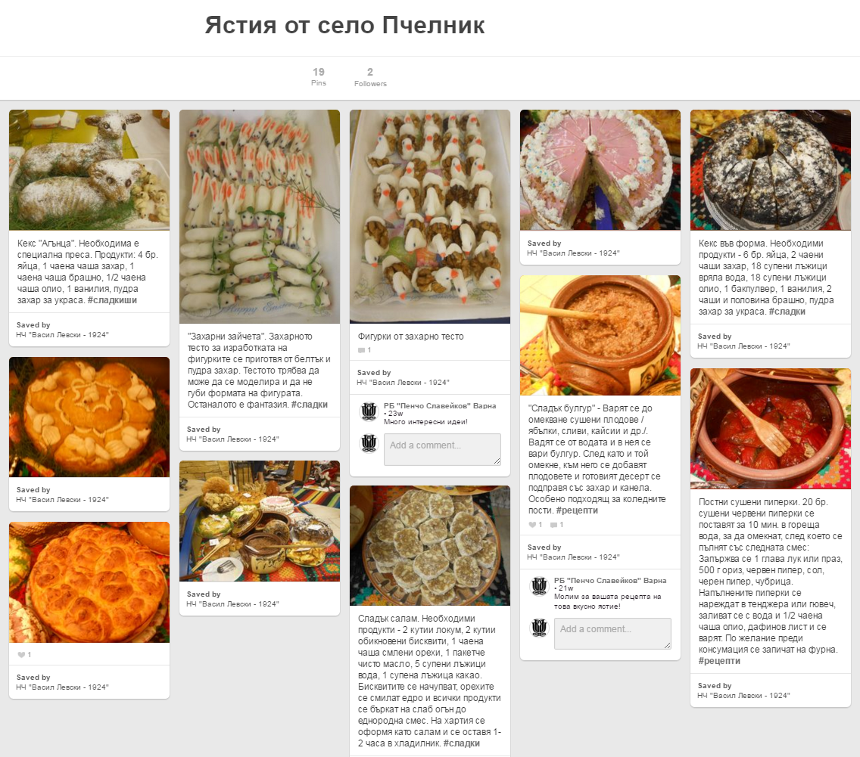
webinars for using social media

Slide 11
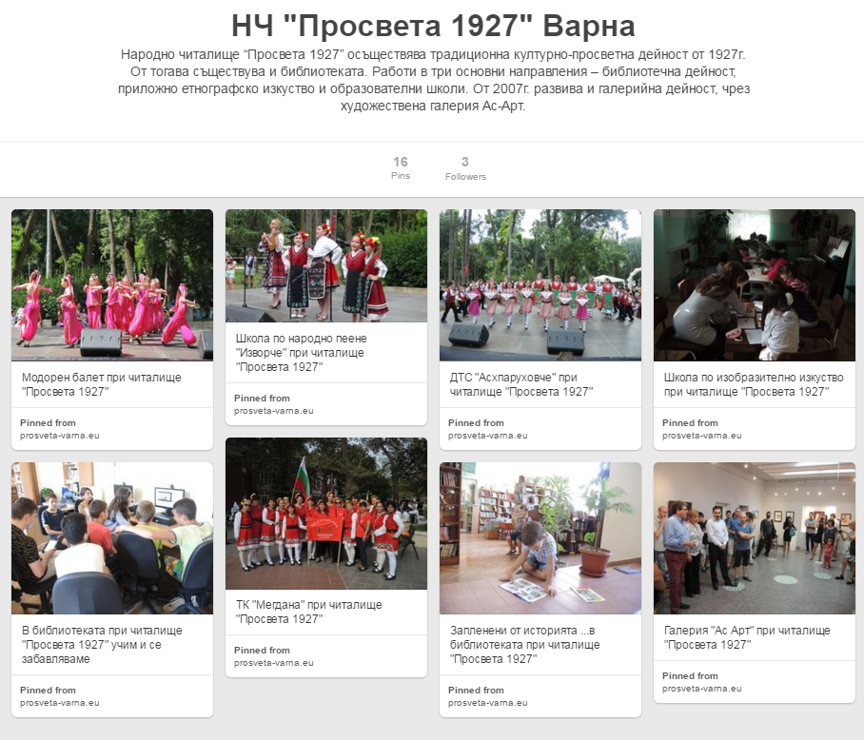
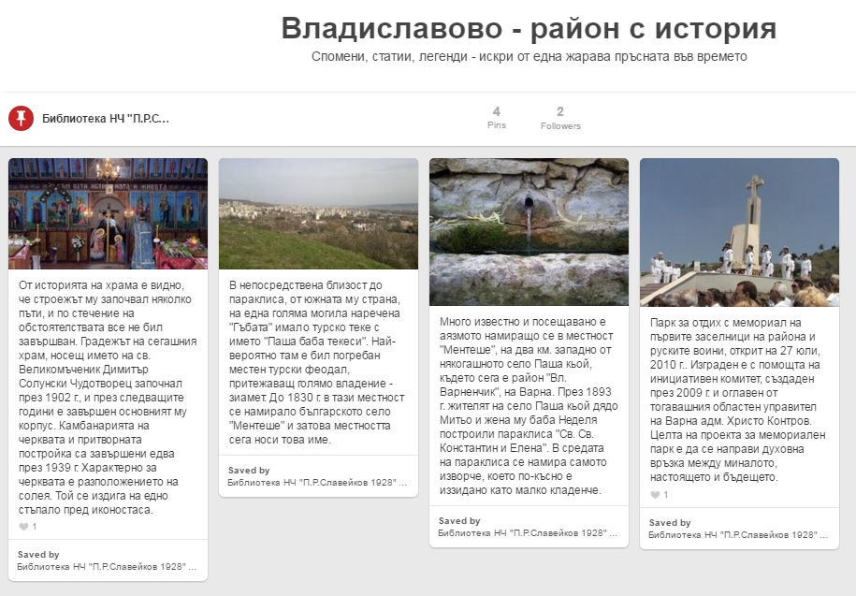
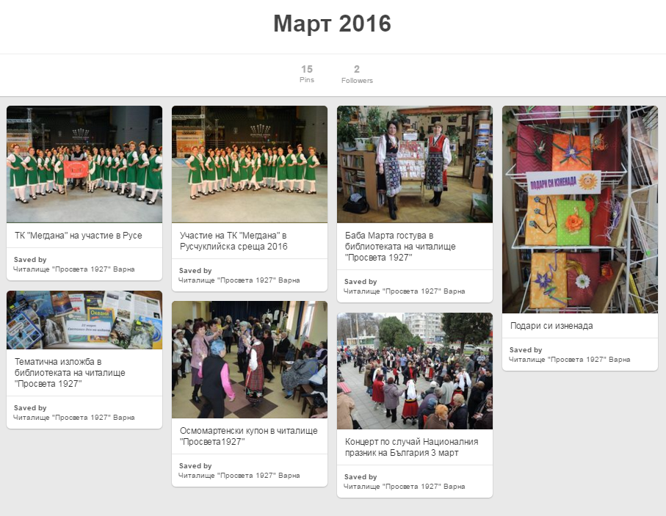
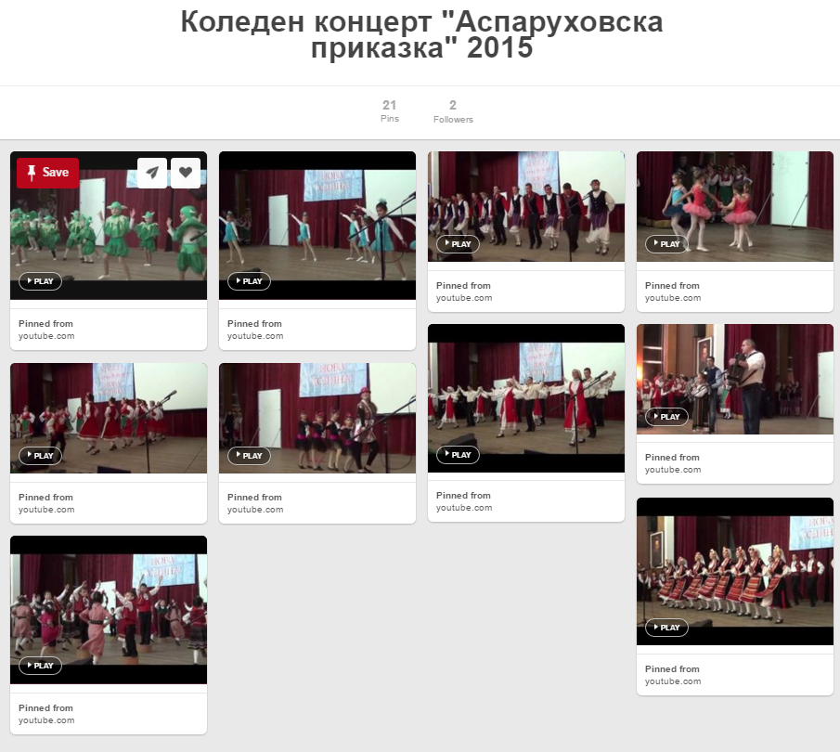
webinars for using social media
Notes:
Insert a map of your country.

Slide 12
webinars for using social media
Challenges
Active presence of libraries on social media
Promoting library collections and services
Stimulating users to use information online instead of from traditional sources
Notes:
Insert a map of your country.

Slide 13
webinars for using social media
Outcomes
Reaching more users
Attracting new users
Promoting library and library events on social media
Trying to become a ‘green library’
Notes:
Insert a map of your country.

Slide 14


Digital curator
Digital Curator is an online service based on play-and-learn method of training. As a result virtual exhibitions of Varna Digital Library content are created.
Notes:
Insert a map of your country.

Slide 15
Digital curator
Background for developing the service
Varna Digital Library content
Experience in organizing exhibitions - traditional and virtual
Interest towards the history of Varna
Notes:
Insert a map of your country.

Slide 16
Digital curator
Target groups
Users of Varna Digital Library
Museum and archive specialists
Explorers of the local history
Teachers
Cognitive games players
Notes:
Insert a map of your country.

Slide 17
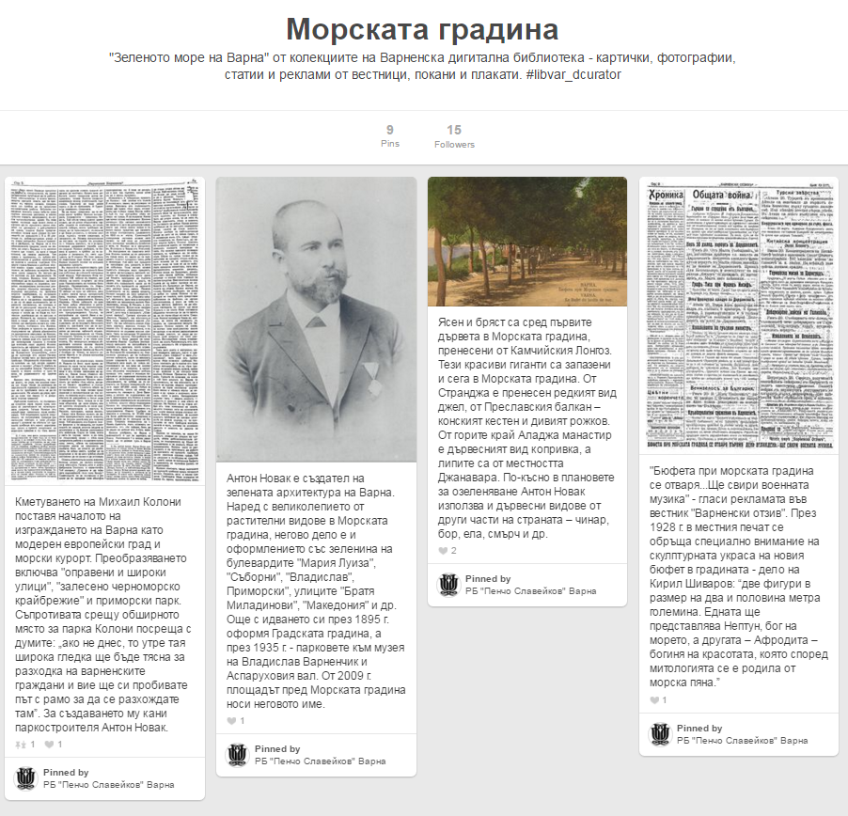
Digital curator
‘Digital Curator’ Webinar in December 2015
Explaining the rules
Presenting the first topic ‘Winter in Old Varna’
Notes:
Insert a map of your country.

Slide 18
Digital curator
‘Digital Curator’ Webinar – Part 2
The boards created by users on Pinterest under the first proposed topic ‘Winter in Old Varna’ were shown
Notes:
Insert a map of your country.

Slide 19
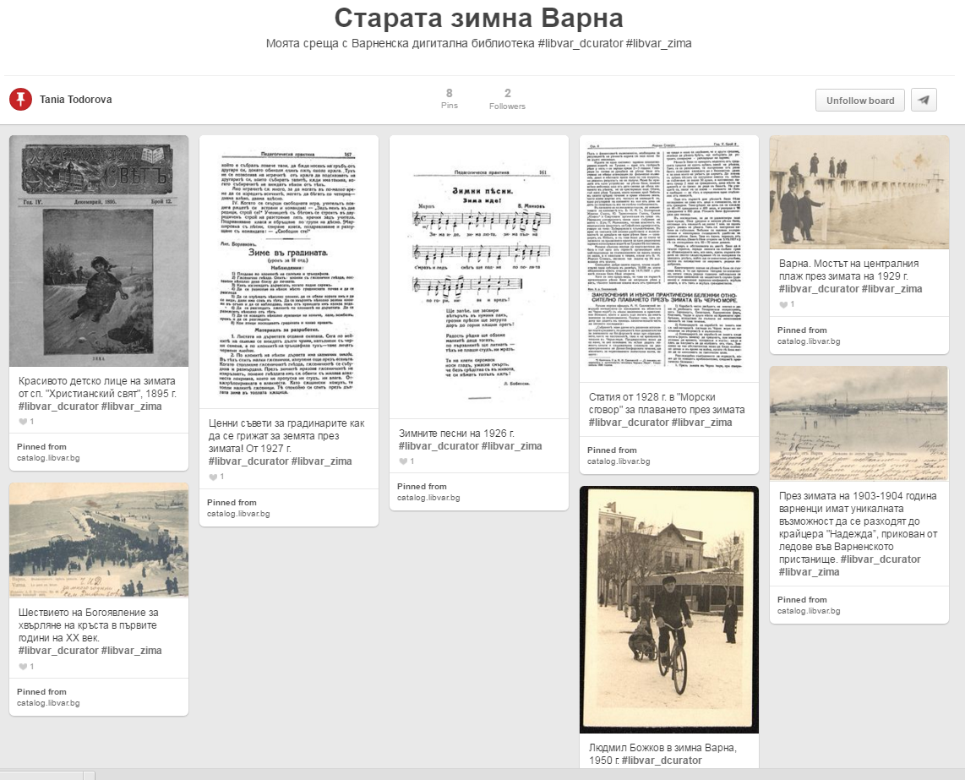
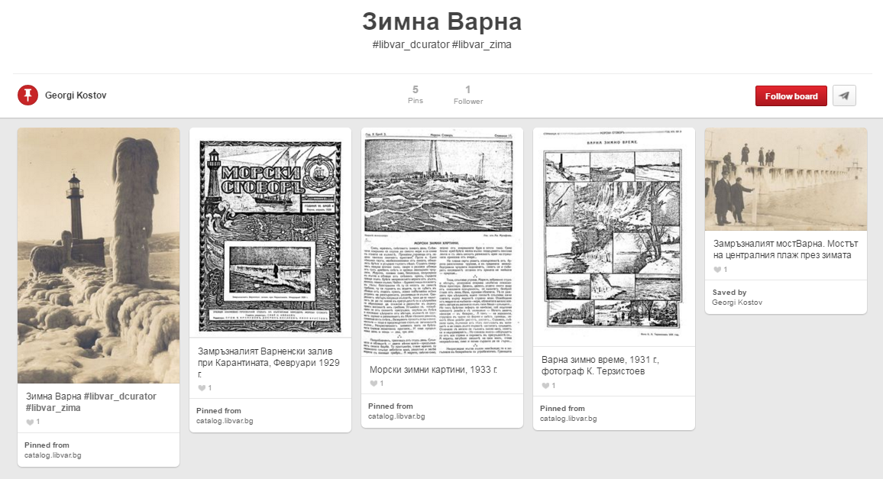
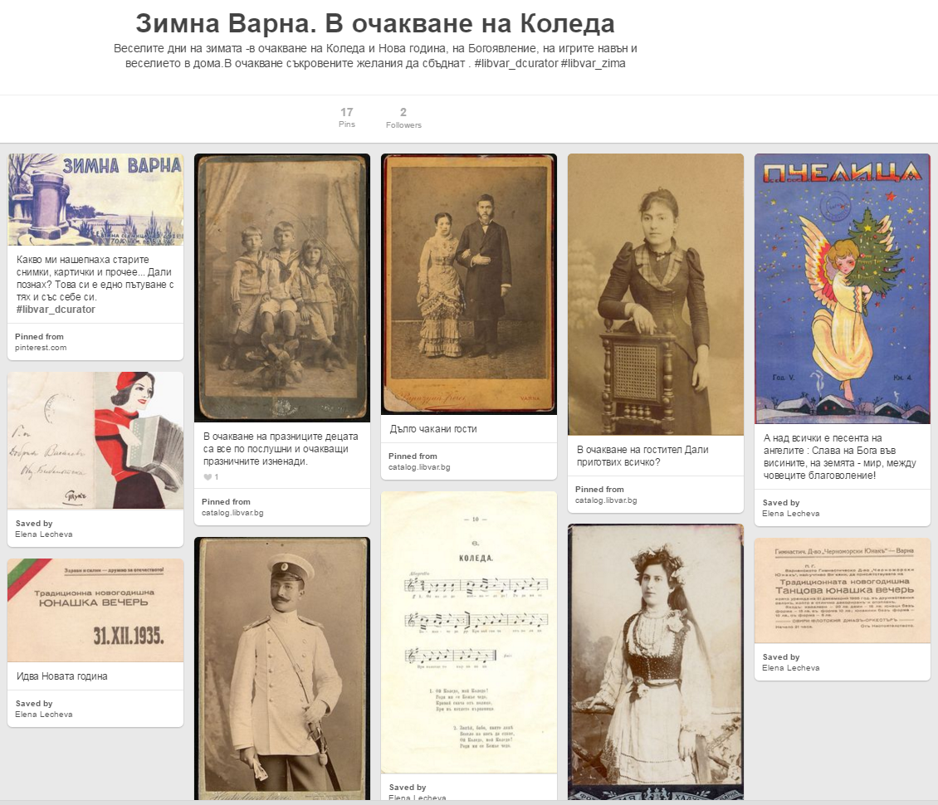
Digital curator

Slide 20
Digital curator
Challenges
Active presence of the public libraries on social media
Reaching new target groups
Stimulating users to use information online instead of from traditional sources
Promotion of Varna Digital Library
Notes:
Insert a map of your country.

Slide 21
Digital curator
Outcomes
Gaining skills for working online
Developing skills for searching information
Getting ‘Likes’ from friends
Becoming a curator of at least one virtual exhibition
Extending knowledge about the history of Varna
Adopting new approach for presenting the cultural and historical heritage
Notes:
Insert a map of your country.

Slide 22
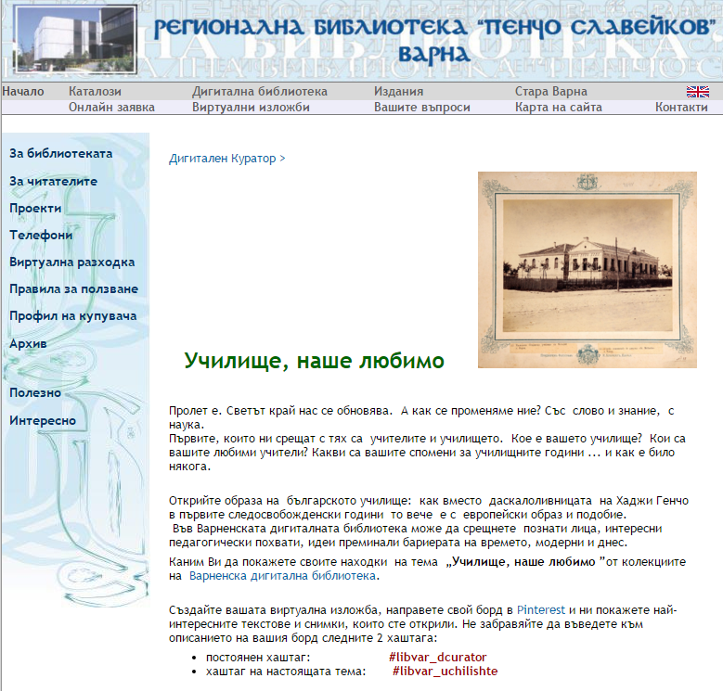
Digital curator
New topic ‘Our Beloved School’

Slide 23

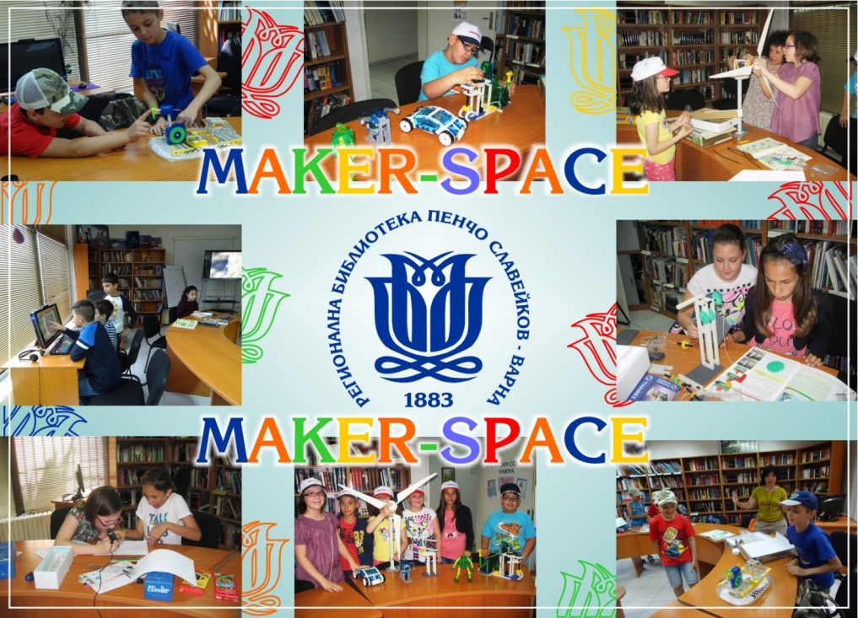
Maker-space
Organizing maker-space workshops in the field of construction, robotics, ecology and modern 3D technology based on STEM education

Slide 24
Maker-space
Background for developing the service
Experience in working with children and teens
Technological resources
Expert capacity
Notes:
Insert a map of your country.

Slide 25
Maker-space
Target groups
Children
Teens and young people
Educational organizations
Notes:
Insert a map of your country.

Slide 26
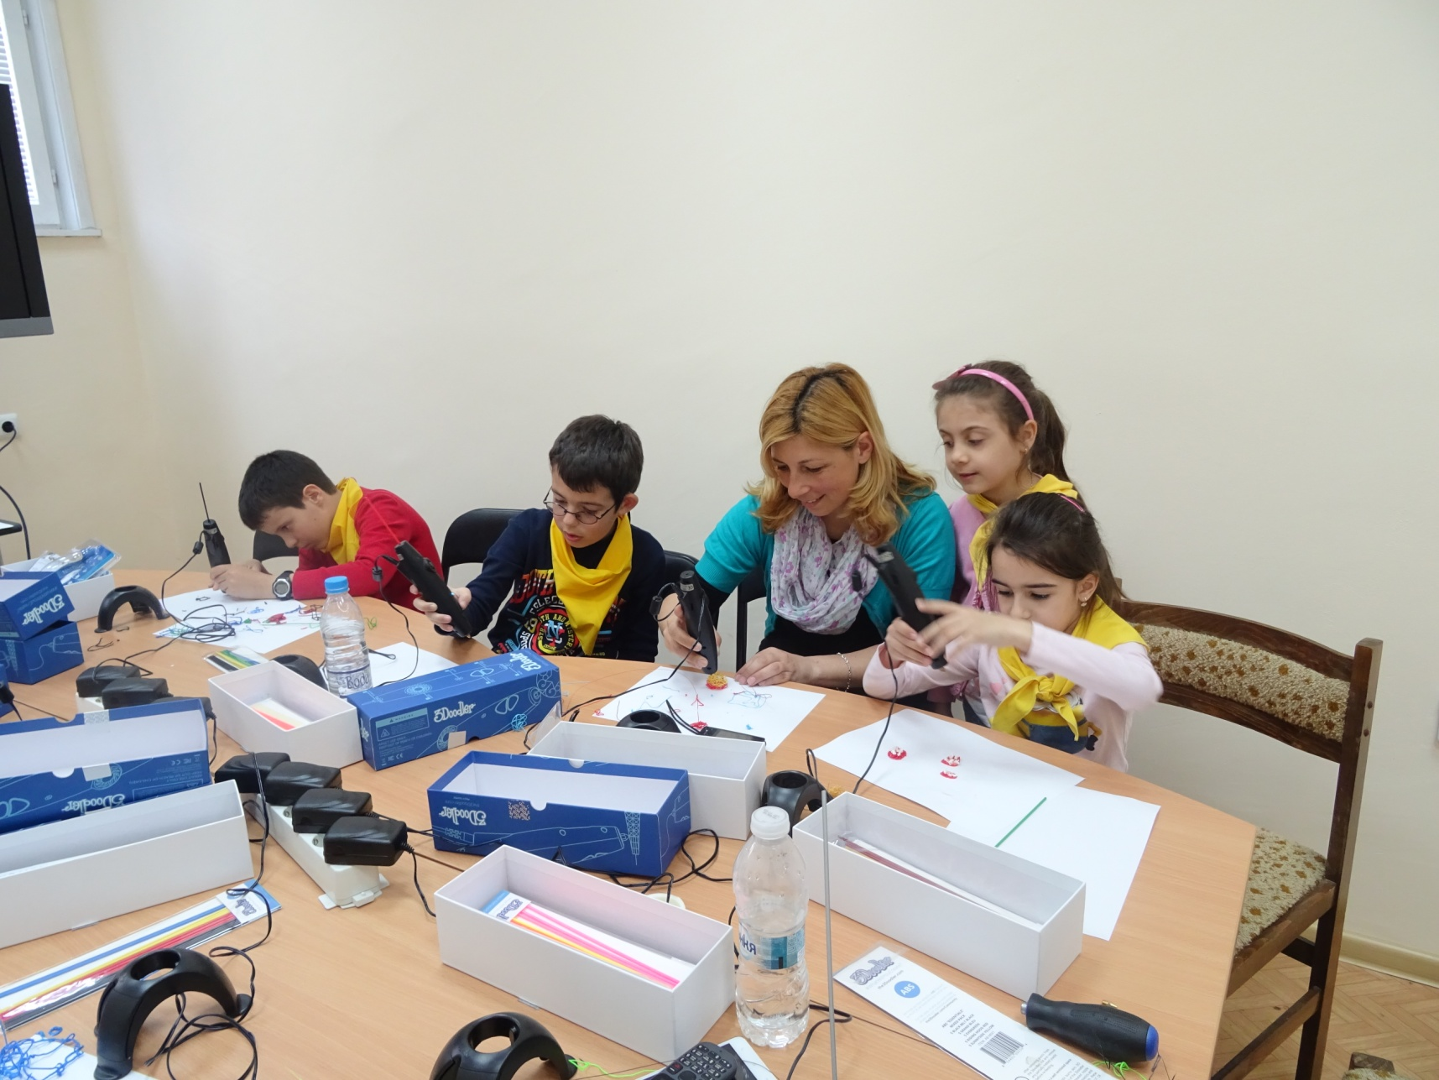
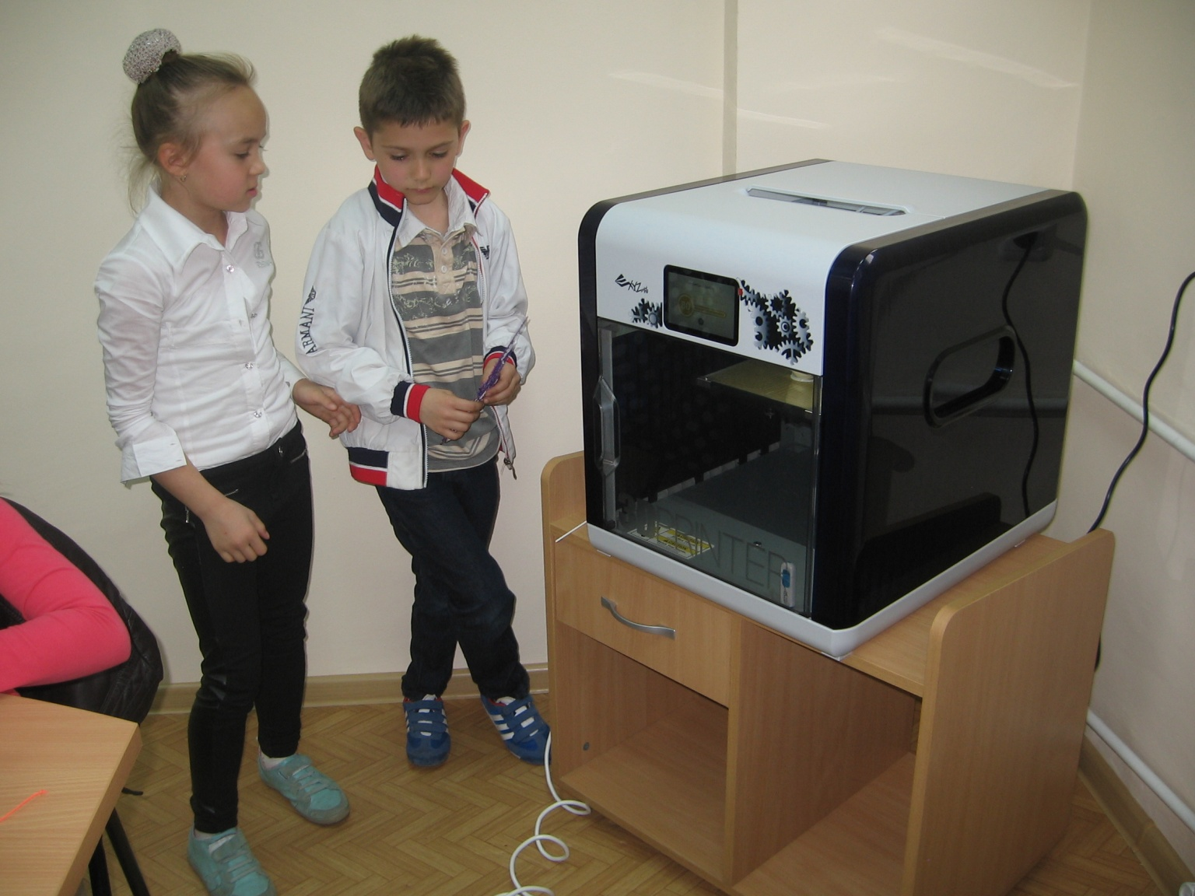
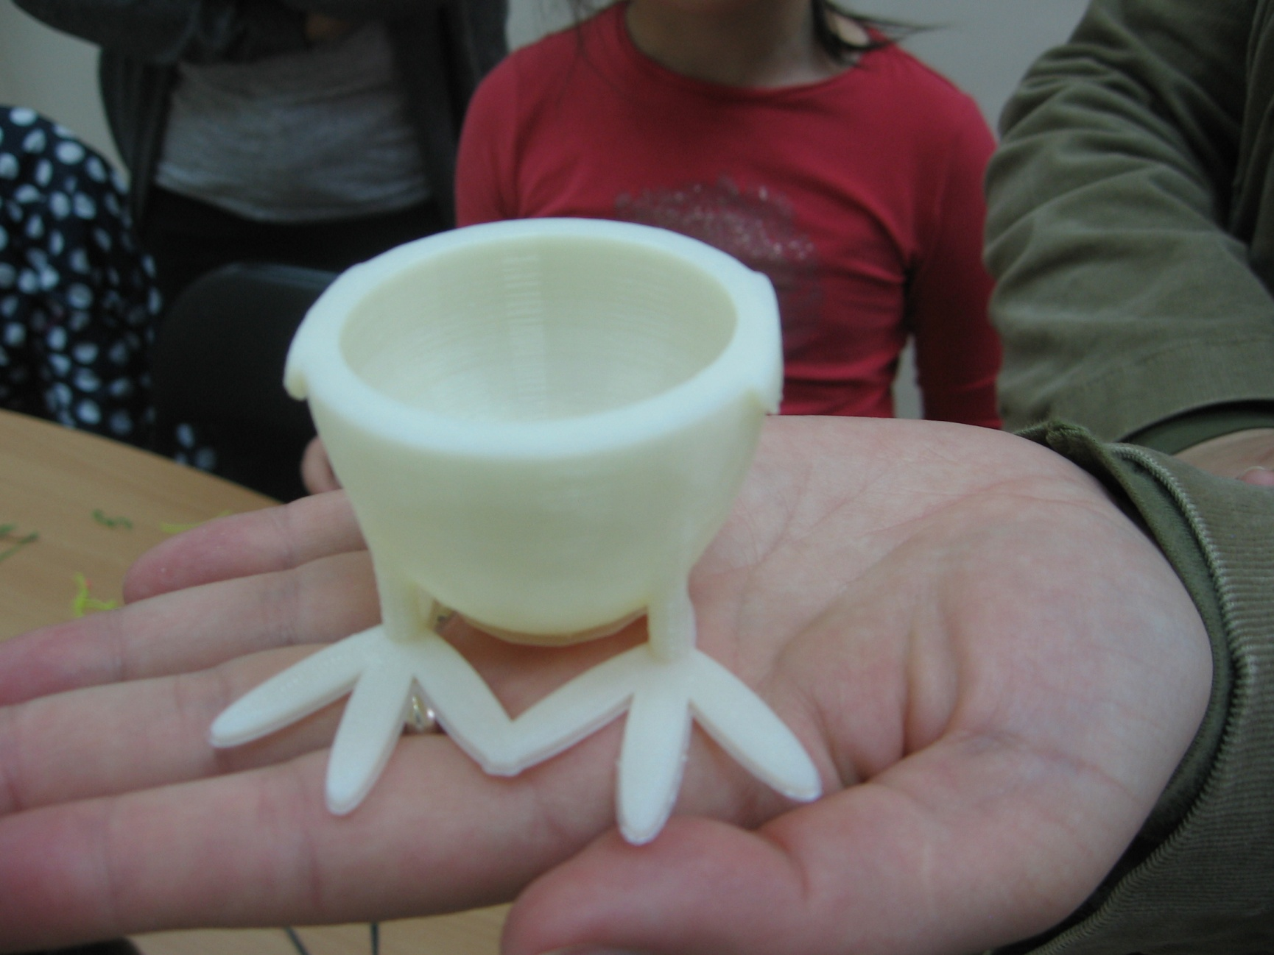
Maker-space
Notes:
Insert a map of your country.

Slide 27
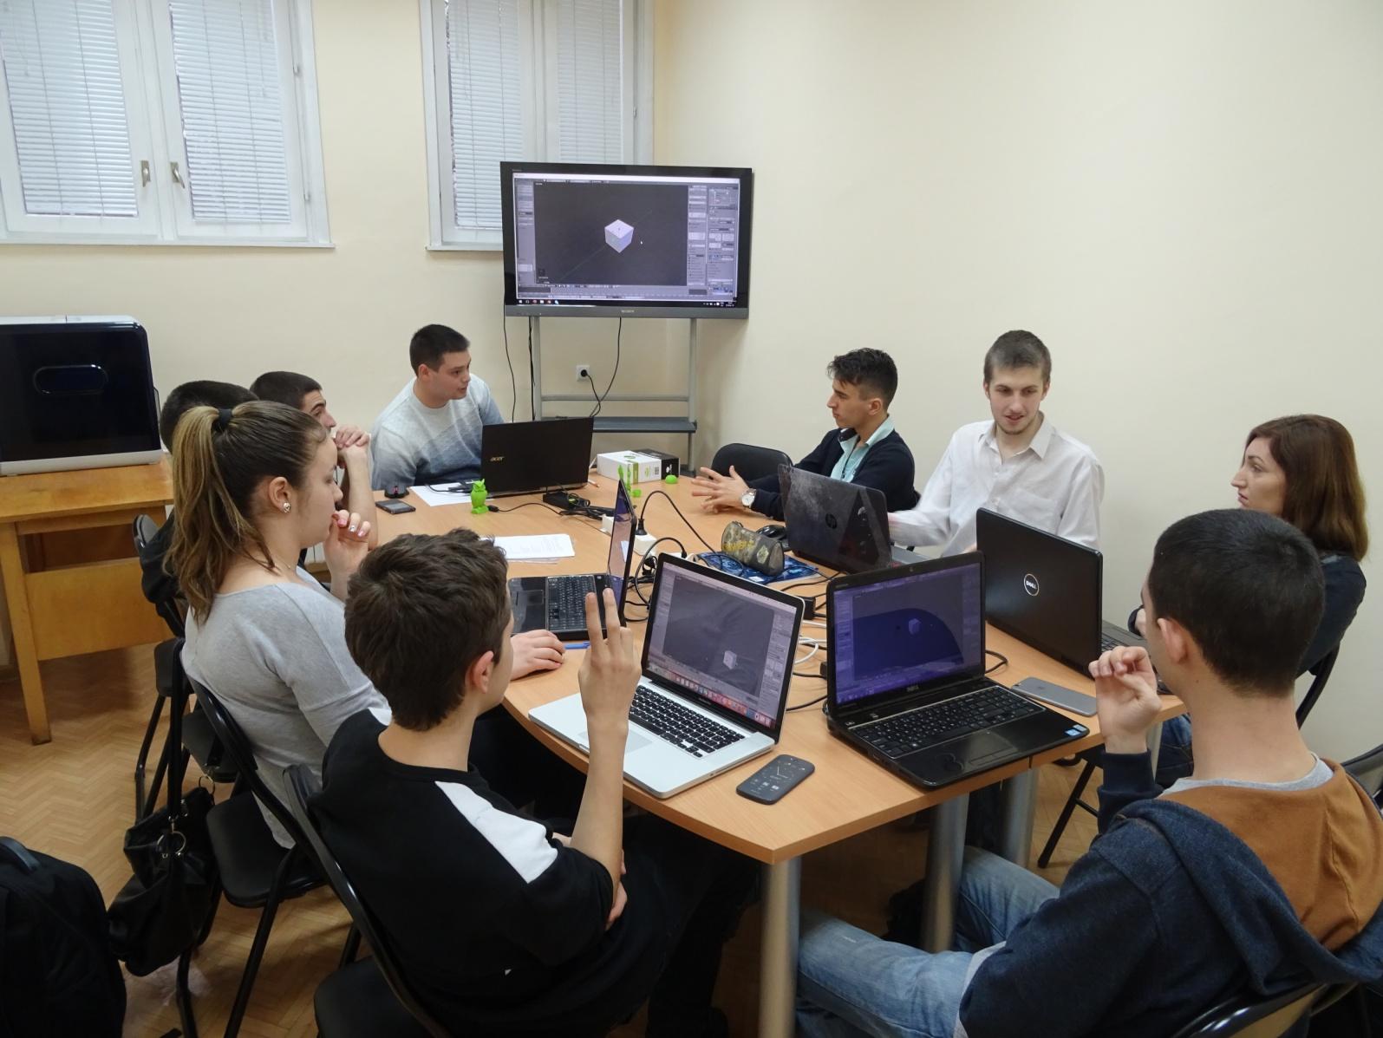
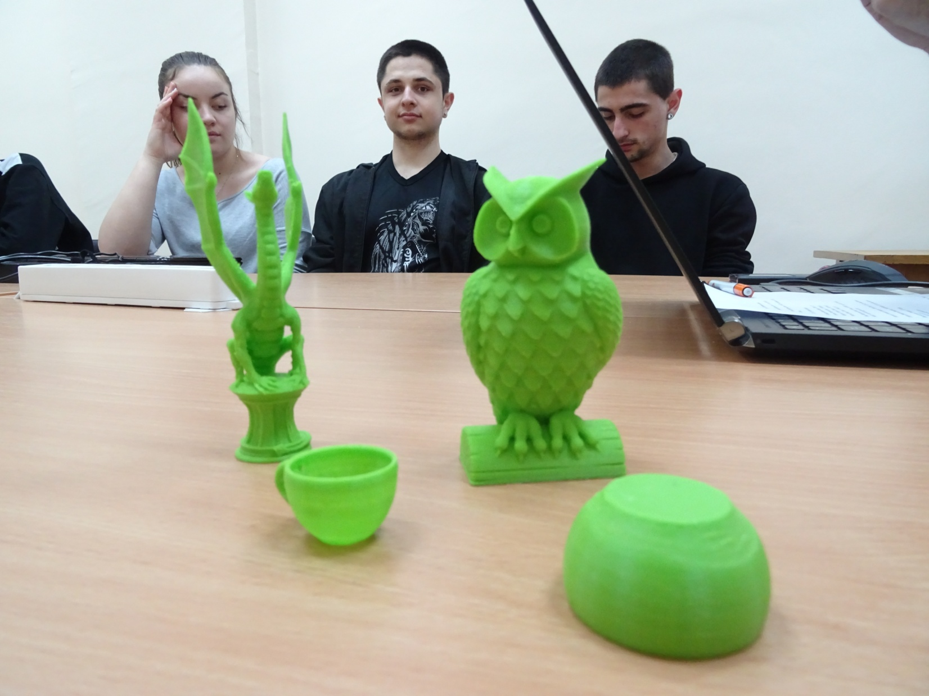
Maker-space
Notes:
Insert a map of your country.

Slide 28
Maker-space
Challenges
Individual approach with the target groups
Breaking stereotypes in the educational models
Knowledge and skills gained in an unusual way
Notes:
Insert a map of your country.

Slide 29
Maker-space
Outcomes
Increasing the creativity and knowledge of the users
Attracting new users
Significant presence of the library in the life of the local community
Notes:
Insert a map of your country.

Slide 30

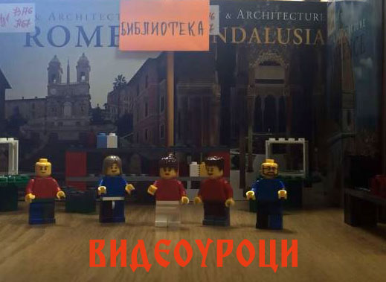
'Library Knowledge' Video Tutorials
Video Tutorials illustrate the services of the library and the access to its information resources
Notes:
Insert a map of your country.

Slide 31
'Library Knowledge' Video Tutorials
Background for developing the service
Already developed video lessons on the library website
Using different online platforms for trainings
Users should be positive towards the innovative services
Notes:
Insert a map of your country.

Slide 32
'Library Knowledge' Video Tutorials
Target groups
Current users of the library
Prospective users of the library
Notes:
Insert a map of your country.

Slide 33
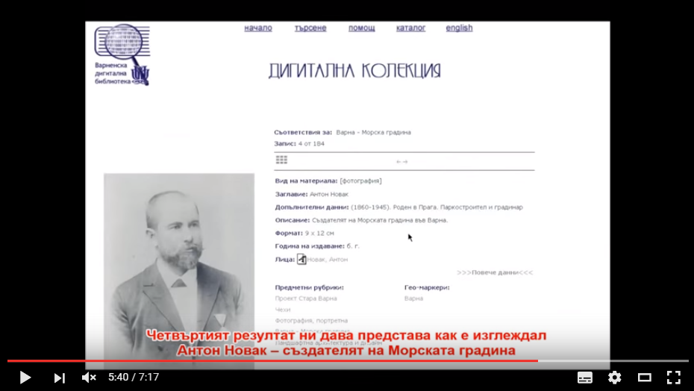
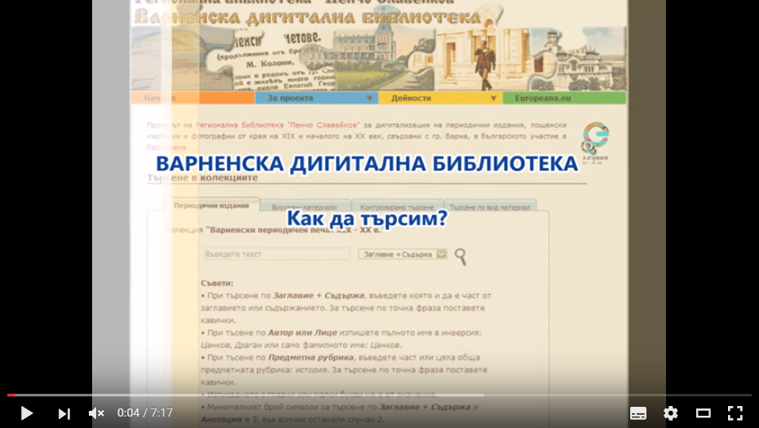
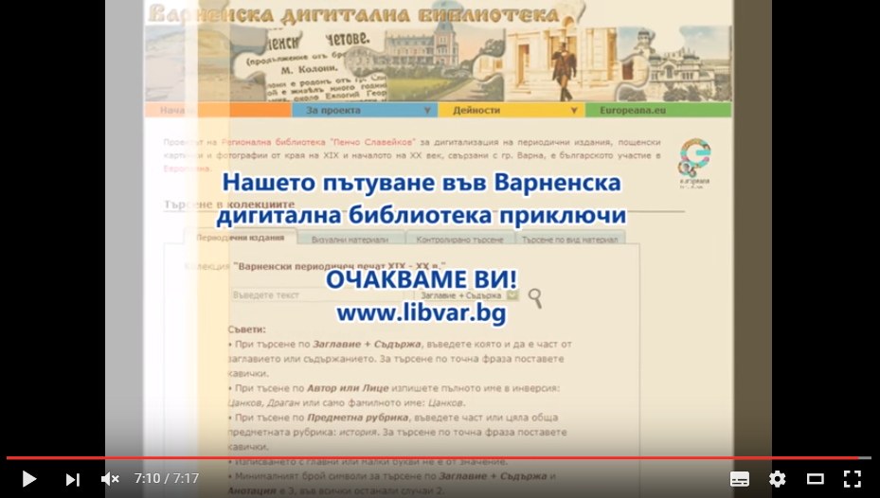
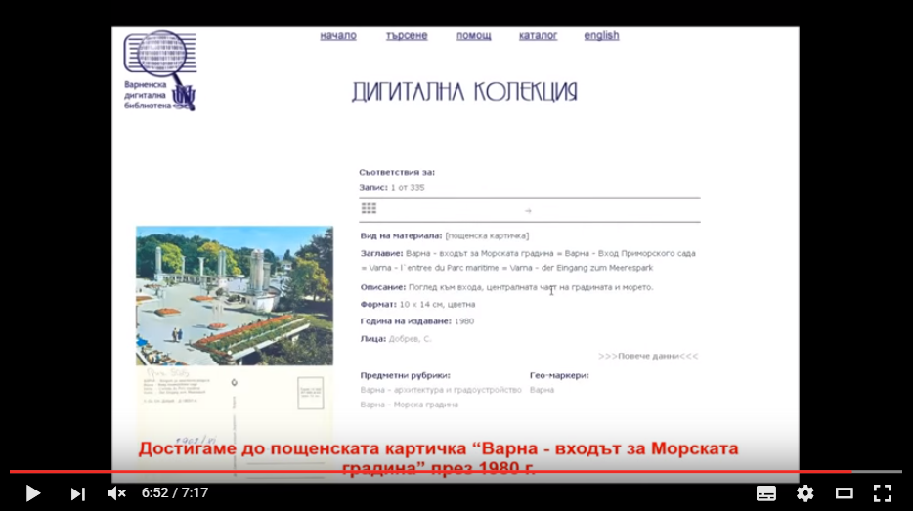
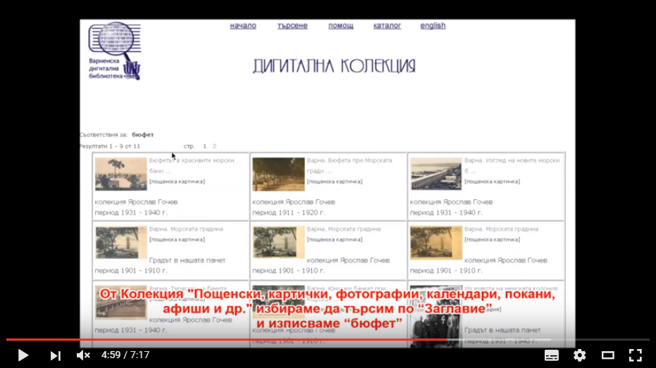
'Library Knowledge' Video Tutorials
Notes:
Insert a map of your country.

Slide 34
'Library Knowledge' Video Tutorials
Challenges
Using unusual methods for training of users
Using mobile apps for creation of video tutorials
Notes:
Insert a map of your country.

Slide 35
'Library Knowledge' Video Tutorials
Outcomes
Reaching more users
Satisfying the users’ information needs
Online presence of the library
An opportunity for the librarians to gain new skills and to broaden their knowledge
Notes:
Insert a map of your country.

Slide 36

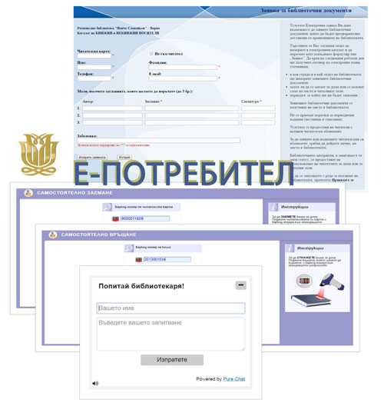
E-USER E-Services for the Library Users
E-USER - a number of e-services
giving the opportunity for
personalization when using
the library
The library is one ‘click’ away!
Notes:
Insert a map of your country.

Slide 37
E-USER E-Services for the Library Users
Background for developing the service
Long time experience in applying ICT
Completely computerized Library Information and Technology System
Library Database
Notes:
Insert a map of your country.

Slide 38
E-USER E-Services for the Library Users
Target groups
ALL USERS
Notes:
Insert a map of your country.

Slide 39
E-USER E-Services for the Library Users
On this stage the е-services include:
Online Request for using library documents
‘Ask a Librarian’ – live chat with a librarian
Self Check-In of library items
Self Check-Out of library items
Notes:
Insert a map of your country.

Slide 40
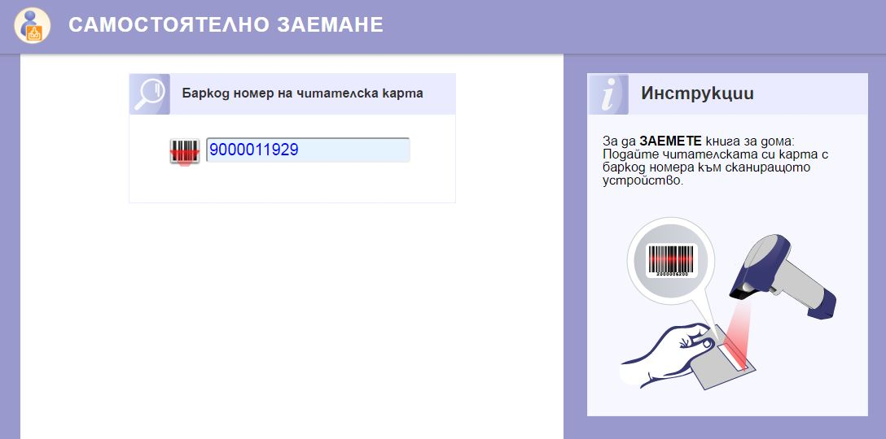
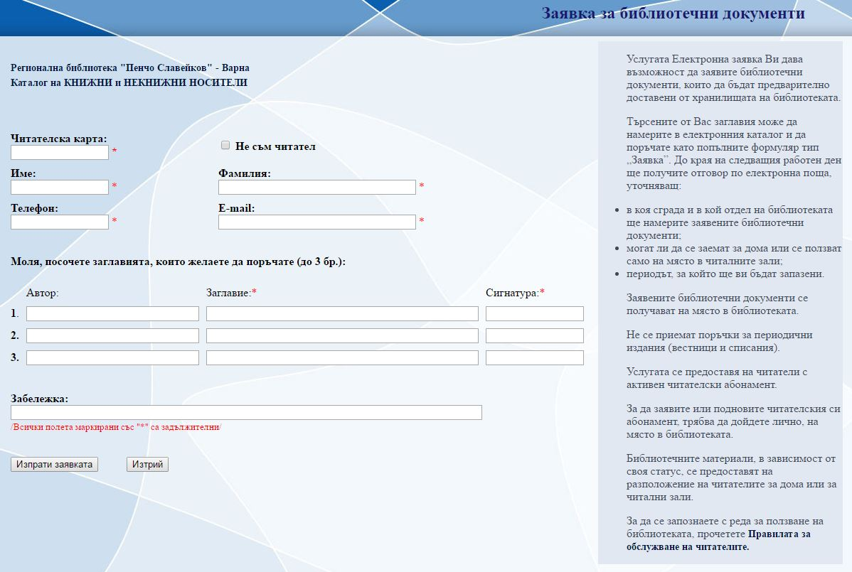

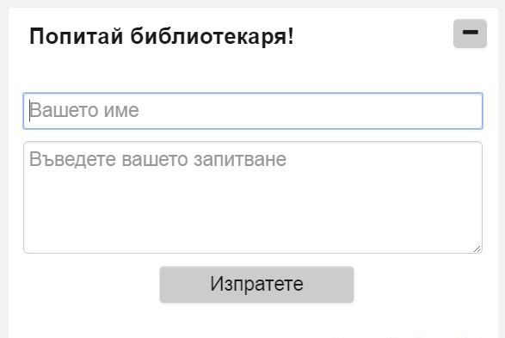
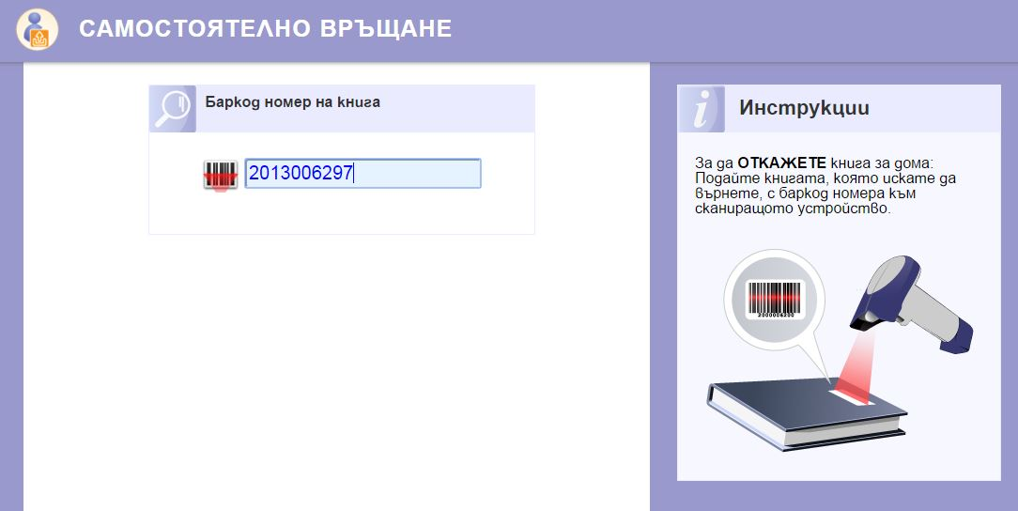
E-USER E-Services for the Library Users
Notes:
Insert a map of your country.

Slide 41
E-USER E-Services for the Library Users
Challenges
Active communication ‘User–Librarian’
Attracting new target groups
Stimulating users to use information online
Notes:
Insert a map of your country.

Slide 42
E-USER E-Services for the Library Users
Outcomes
Modernization of the library process
Increasing the usability of the library outside the opening hours
Easier communication
Saving users’ time & money
Active position when using the library services
Notes:
Insert a map of your country.

Slide 43
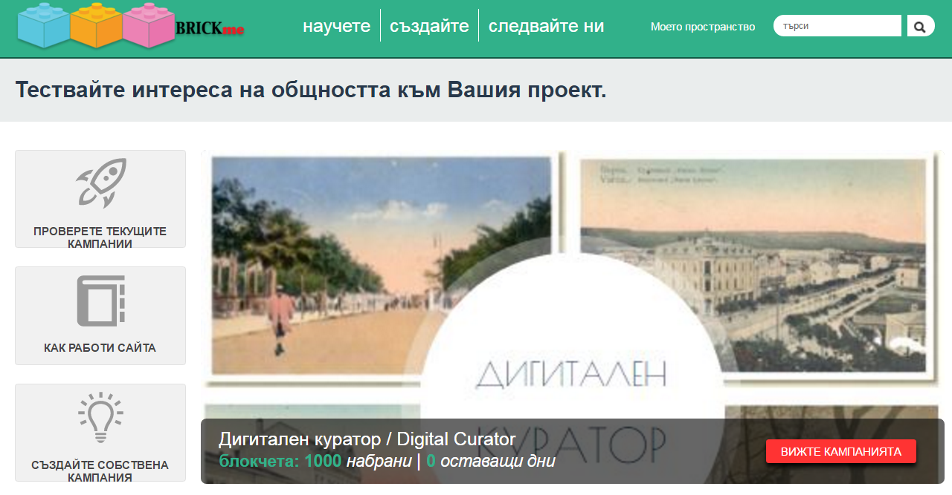
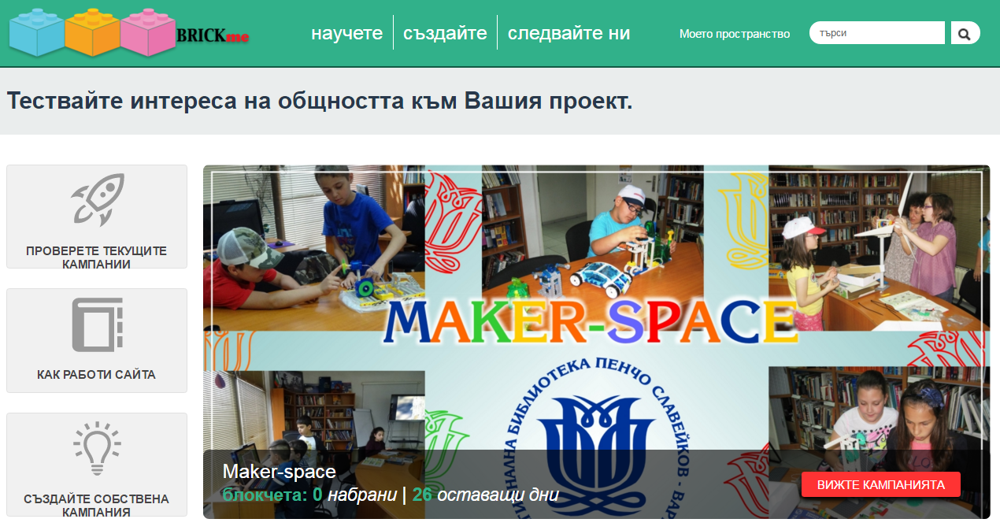
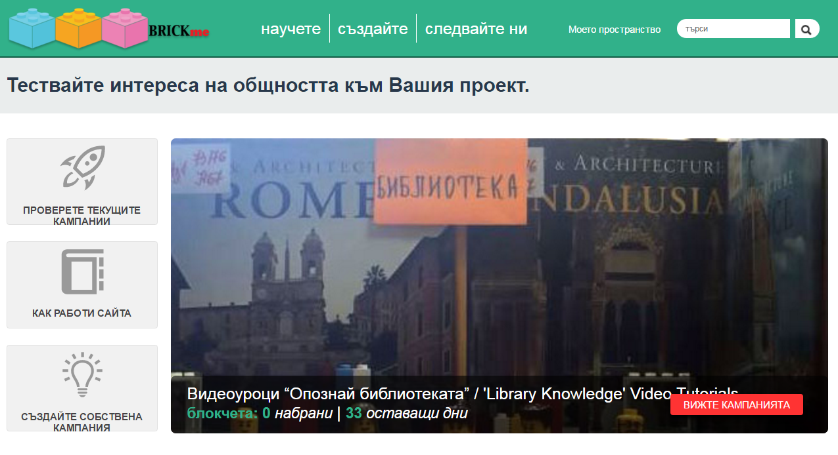
http://platform.brickme.org/
Notes:
Insert a map of your country.

Slide 44
Lets turn our library into a place for everyone!
Temenuga Kalcheva Denitsa Cholakova
temenuga@libvar.bg dcholakova@libvar.bg

